Slide 1
The Newsvendor Problem: Example
O’Neill , an apparel company, located in US, has to decide on the number of wetsuits to be purchased for the summer season. Based on past demand data, management has forecast demand to be uniformly distributed between 0 and 1000. The wetsiut is manufactured by a contract manufacturer located in China. Hence, the order has to be placed in advance as the lead time is very high. Each wetsuit costs Rs. 2500 and retails for Rs. 5000. Any unsold wetsuit at the end of the season are sold to discount stores at Rs. 2000. O’Neill has somehow quantified the goodwill loss due to stockout of wetsuit as Rs. 1500.
How many wetsuits should O’Neill order with their contract manufacturer to maximize expected profit?

Slide 2
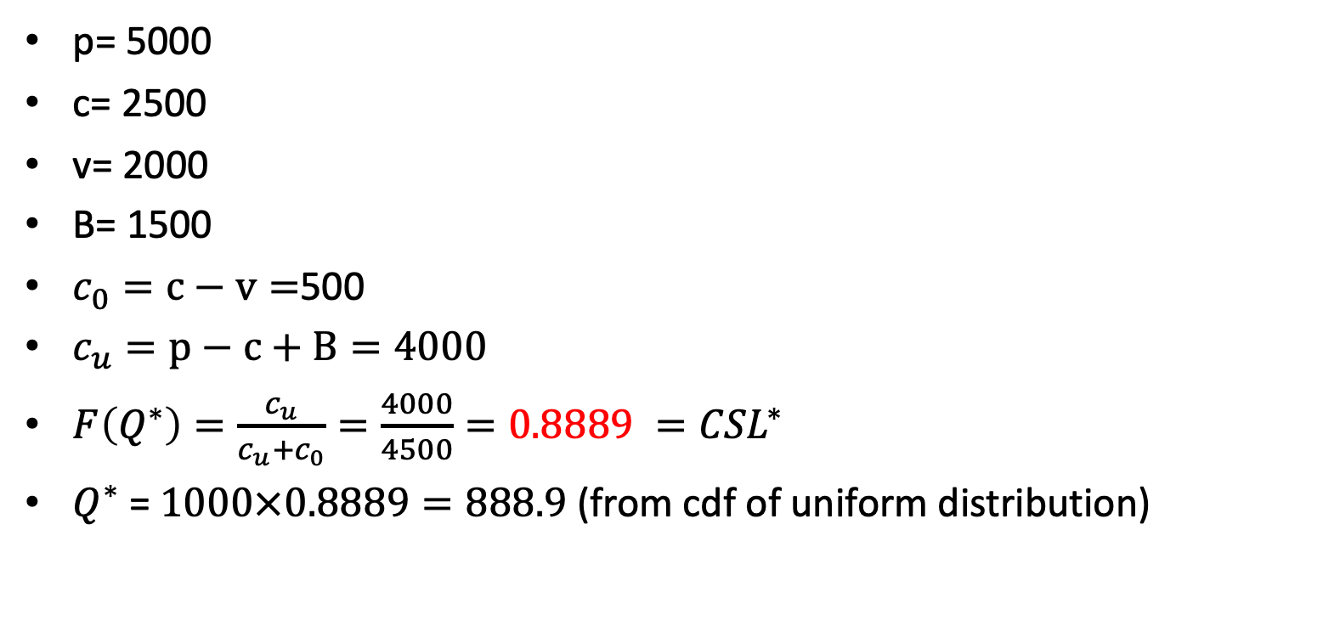
p= 5000
c= 2500
v= 2000
B= 1500
$c_{0}=c−v=$500
$c_{u}=p−c+B=4000$
$F\left(Q^{∗}\right)=\frac{c_{u}}{c_{u}+c_{0}}=\frac{4000}{4500}=0.8889 ={CSL}^{∗}$
$Q^{∗}$ = $1000×0.8889=888.9$ (from cdf of uniform distribution)

